Slide 1
Client Management System (CMS) for Land Real Estate
Student Name: Ochom Marcus Ethine Reg No: 2025/BCS/153/PS

Slide 2
Executive Summary
Problem: Real estate land sales rely on manual records → inefficiencies, data inconsistencies, poor customer service.
Solution: A Client Management System (CMS) that centralizes client, property, and sales data.
Technology: MySQL for data insertion, modification, deletion, and queries.
Outcome: Better decision-making, improved customer relationships, increased revenue.

Slide 3
Business Case & Application Domain
Purpose: Solve land ownership disputes and manage client relationships.
Operations Supported:
Client registration & profile management
Land listing, tracking, and inquiries
Document management (agreements, titles, contracts)
Target Users:
Real estate agents
Administrative staff
Company management

Slide 4
Analysis of Benefits
Tangible Benefits
Intangible Benefits
Faster data access
increased sales tracking accuracy
Better reporting
Time savings via automation
Enhanced customer satisfaction
Improved decision-making
Professional company image
Better staff-client communication

Slide 5
Analysis of Costs
Tangible Costs
Intangible Costs
Hardware (computers, servers)
Development time & labor
System maintenance & updates
Staff training
Resistance to change
Time spent transitioning from old systems

Slide 6
User Issues & Adoption Challenges
Skills Required:
Basic computer literacy
Ability to use database-driven interfaces
Adoption Challenges:
Resistance from staff used to manual systems
Learning curve for new users
Mitigation: User training and simple interface design.

Slide 7
Risk Assessment
Risk Type | Examples | Mitigation
Technical | System bugs, data loss | Regular backups, testing
Organizational | Resistance, poor data entry | User training
External | Cyber threats, power failure | Security measures, access control

Slide 8
Limitations of the System
Limited scalability if not designed properly
Dependence on technology (downtime affects operations)
Requires continuous maintenance & updates
Cannot fully eliminate human data entry errors
Time-consuming initial implementation

Slide 9
Database Design – Entities
Client – stores client details
Plot – stores land/property details
Inquiry – tracks client inquiries on plots
Ownership – records plot ownership status

Slide 10
Attributes per Entity
Entity | Attributes
Client | ClientID, FirstName, LastName, Phone, Email, ClientType
Plot | PlotID, Location, Size, Price
Inquiry | InquiryID, ClientID, PlotID, InquiryDate, InquiryStatus
Ownership | OwnershipID, OwnershipStatus, PlotID, ClientID, TitleStatus

Slide 11
Entity Relationships
Client → Inquiry: One-to-Many
Plot → Inquiry: One-to-Many
Client → Ownership: One-to-Many
Plot → Ownership: One-to-One (current) or One-to-Many (historical)

Slide 12
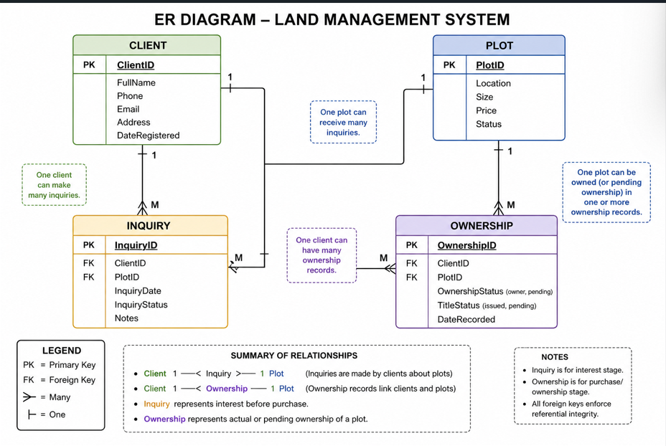
Entity Relationship Diagram (ERD)

Slide 13
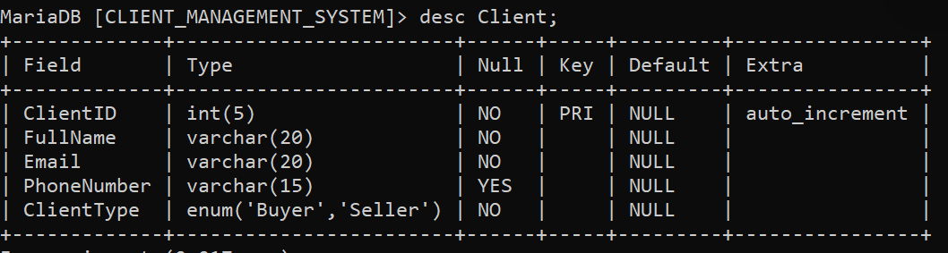
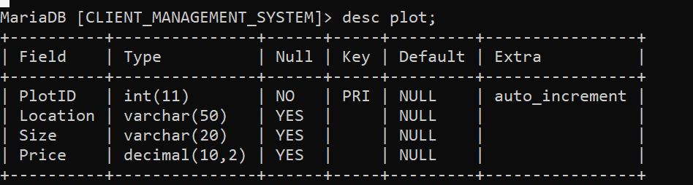
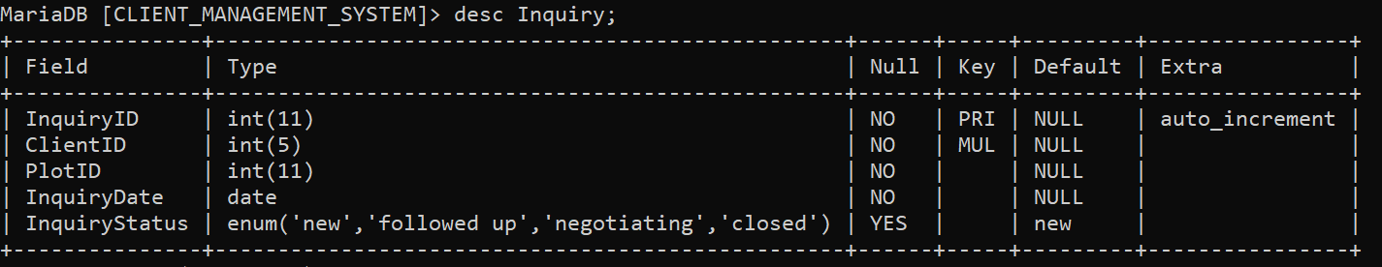
SQL Implementation – Table Creation

Slide 14
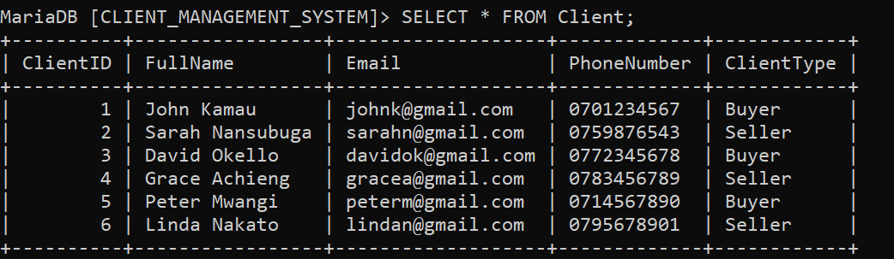
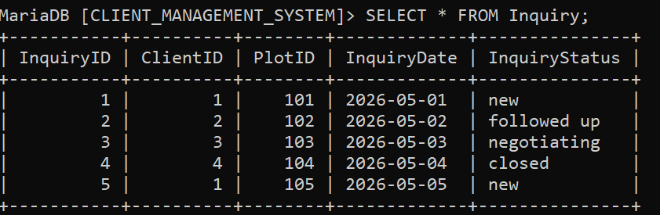
Sample Data Insertion

Slide 15
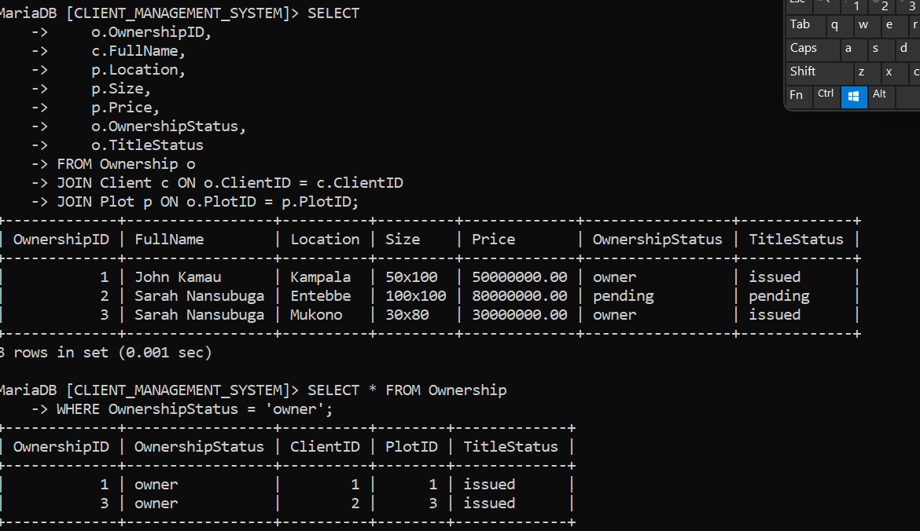
More Sample Queries

Slide 16
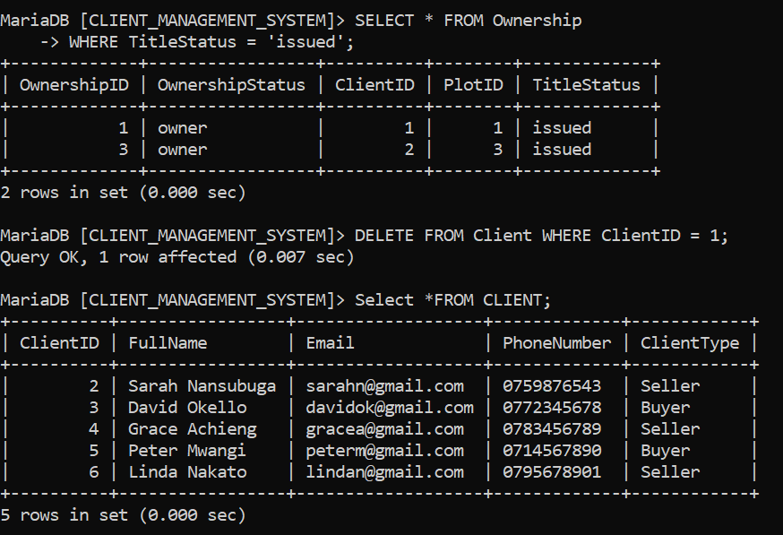

Slide 17
Conclusion
The Land Client Management System successfully:
Digitizes real estate data management
Translates business needs into a functional relational database
Improves efficiency, transparency, and customer service
Provides a scalable foundation for future enhancements

